Slide 1

Payout Policy
現金股利與股票回購
湛可南
政大財管
2021

Slide 2
Reappearing dividends
Michaely and Moin, JFE 2022

Slide 3
Reappearing dividends
Why the fraction of dividend-paying firms falls from 73% in 1978 to 23% in 2000 and then increases to 36% in 2018 ? What causes firms to change their behavior ?

Slide 4
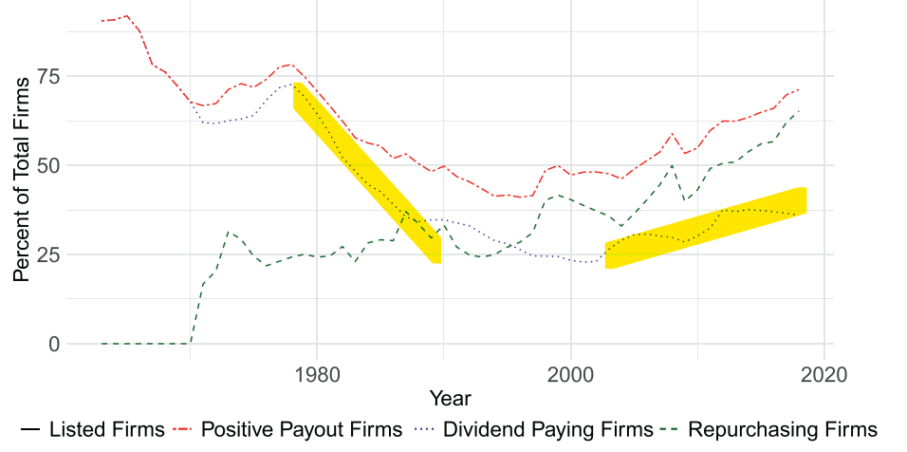
Reappearing dividends

Slide 5
Research hypotheses
changes in the relation between the fundamental characteristics and the decision to pay dividends
changes in the distributions of fundamental characteristics, such as profitability and earnings volatility
examine changes in market conditions (e.g. SEC rule 10-b)

Slide 6
Contribution of changes in firm characteristics and proclivity to pay
Contribution in 2000: (disappearing dividend)
Changes in proclivity to pay: 47.38 %
Changes in firm characteristics: 52%
(lower profitability and higher earnings volatility)
Contribution in 2018: (reappearing dividend)
Changes in proclivity to pay: 81.72 %
Changes in firm characteristics: 18.28%
(earnings volatility drives the result)

Slide 7
Changes in firm characteristics and proclivity to pay
Earnings volatility has the largest impact on firm characteristics disappearing-dividends period
profitability contributes significantly to the dividend disappearance
A large shift in firm characteristics between each period
Earnings volatility is the only characteristic that contributes materially to the reappearing dividends phenomenon

Slide 8
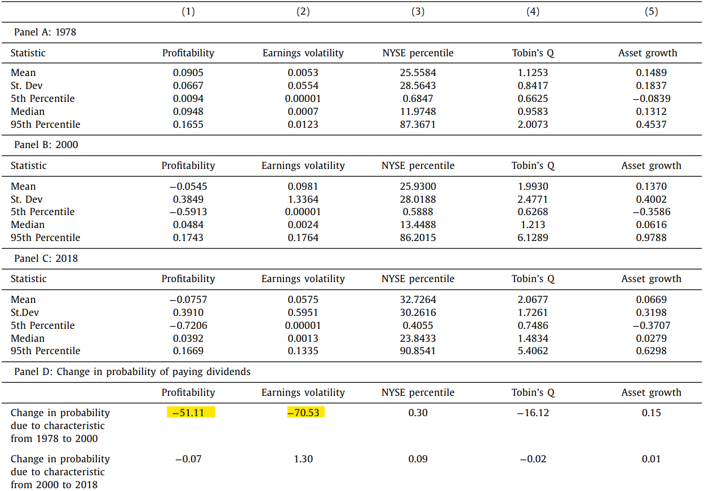
Changes in firm characteristics and proclivity to pay

Slide 9
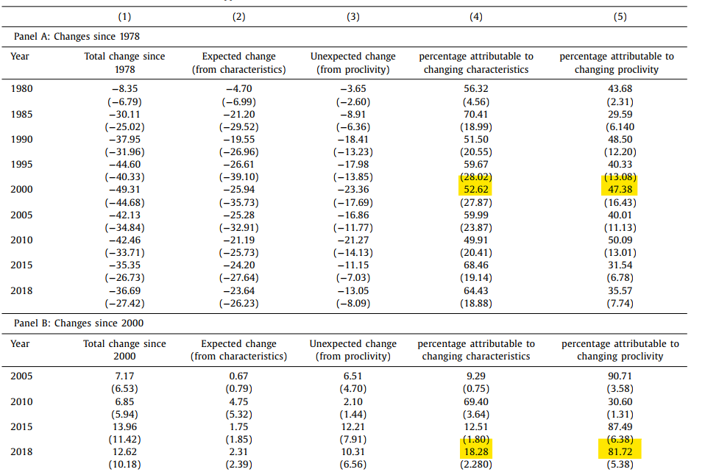
Contribution of change in firm characteristics and proclivity to pay

Slide 10
Changes in Proclivity to pay
Two main source of changes in Proclivity of paying dividends
Change in regulatory structure
Firm delisting

Slide 11
Relationship between regulatory structure and payout
Regulatory structure
SEC rule 10b-18 (1982) makes firms easier to repurchase shares instead of paying dividends
Evidence: firms overall payout is gradually higher even while dividend reappear
Firm Delisting (Technology Firms):
Prior research: high earnings volatility firm could be reluctant to pay dividend. So technology bubble might cause dividend reappearing.
Few technology firms were forced to delist. Reappearing dividend may not be due to technology bubble.
mergers and acquisitions account for approximately two-thirds of the reappearing-dividends phenomenon

Slide 12
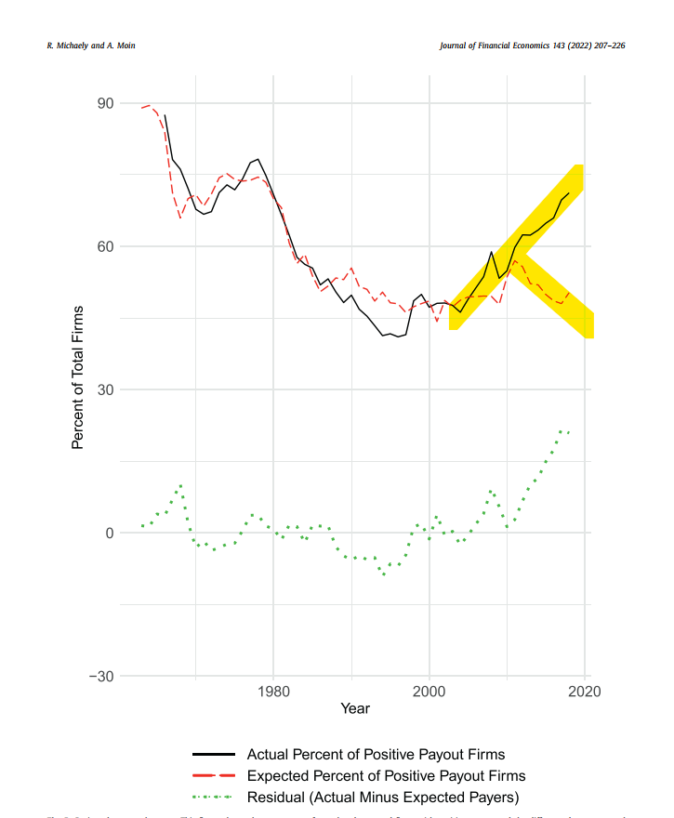
Regulatory structure

Slide 13
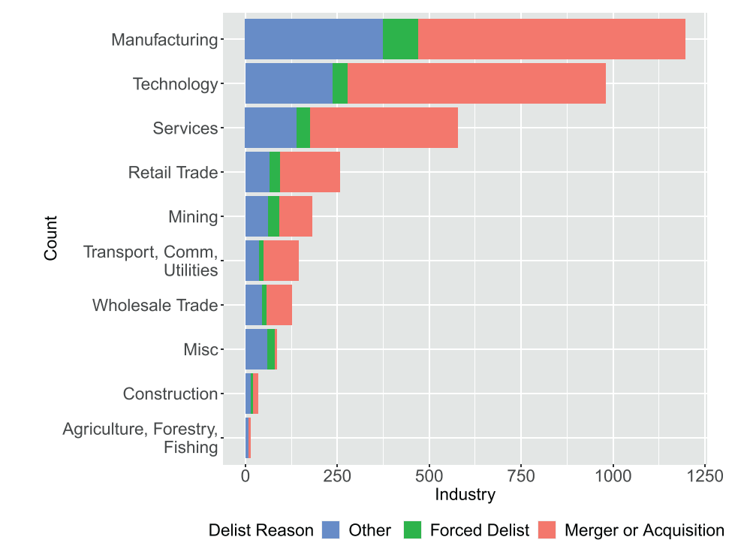
Firm delisting

Slide 14
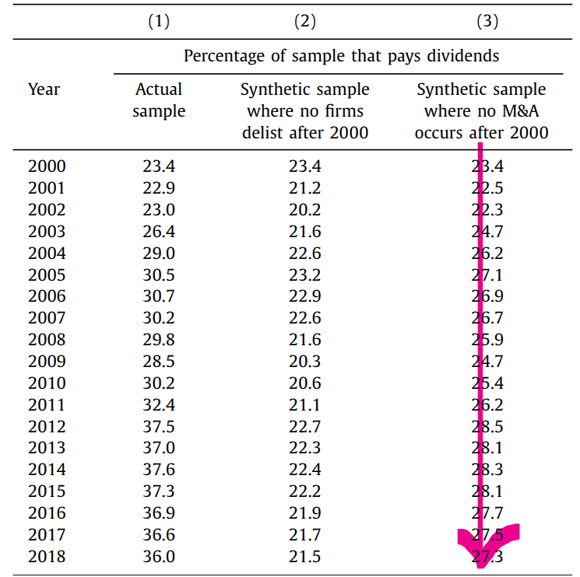
Likely Explanation of Reappearing Dividends

Slide 15
High payout in 2000
Kathleen Kahle/ René M. Stulz and Moin, JFE 2021

Slide 16
Main Topic for Discussion
Why pay out are so high in 2000s?

Slide 17
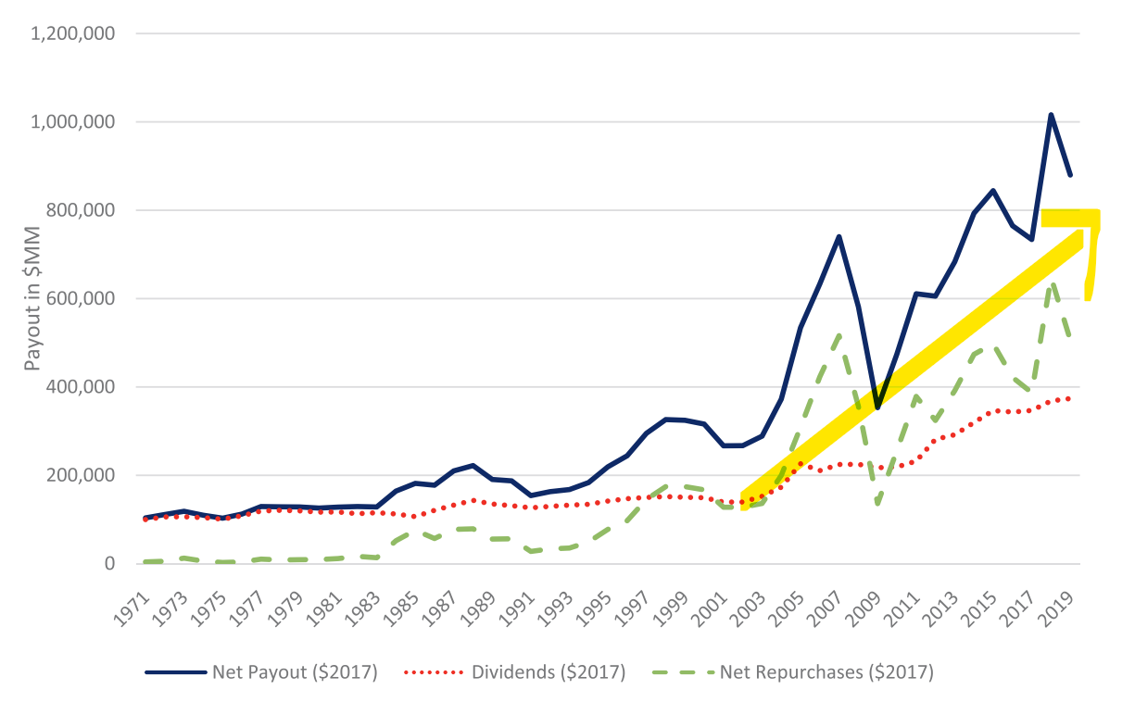
Main Topic for Discussion

Slide 18
Ideas that need to verified
What causes payout?
Will change in firm characteristic explain the increase in payout rate?
How much of the increase in payouts can be explained by changes in firm characteristics?
Other factors besides firm characteristic influencing firm payout

Slide 19

What causes payout ?
Operating Income → 37 %
Payout Rate → 63%

Slide 20
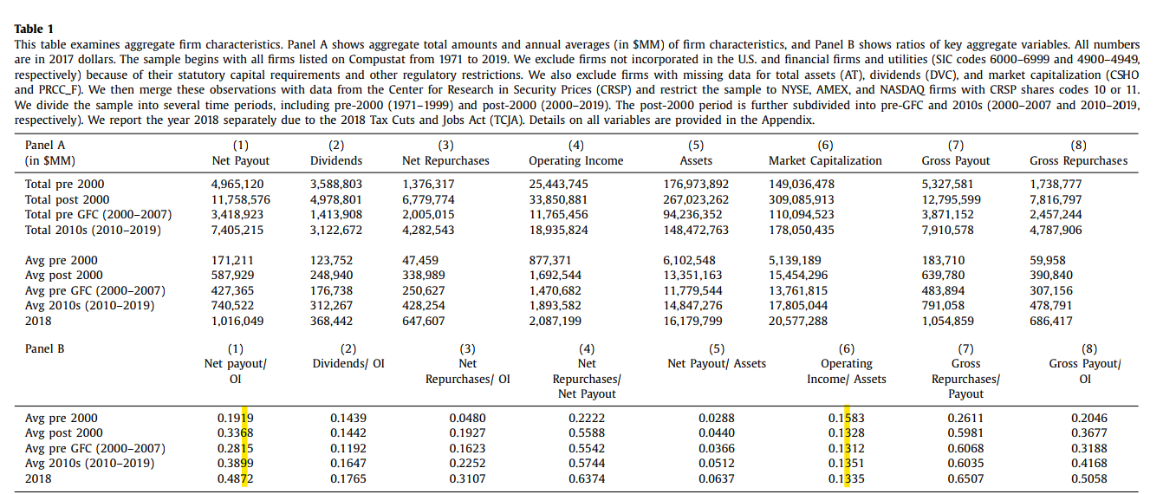
What causes payout ?

Slide 21
Can Macroeconomic Factor Explain Payout?
The change in Macroeconomic factor might cause the operating income to fluctuate leading to a change in Payout
The study Include Macroeconomic factor such as GDP
The study has shown that macroeconomic variables do not help predict aggregate payouts once one accounts for aggregate earnings

Slide 22
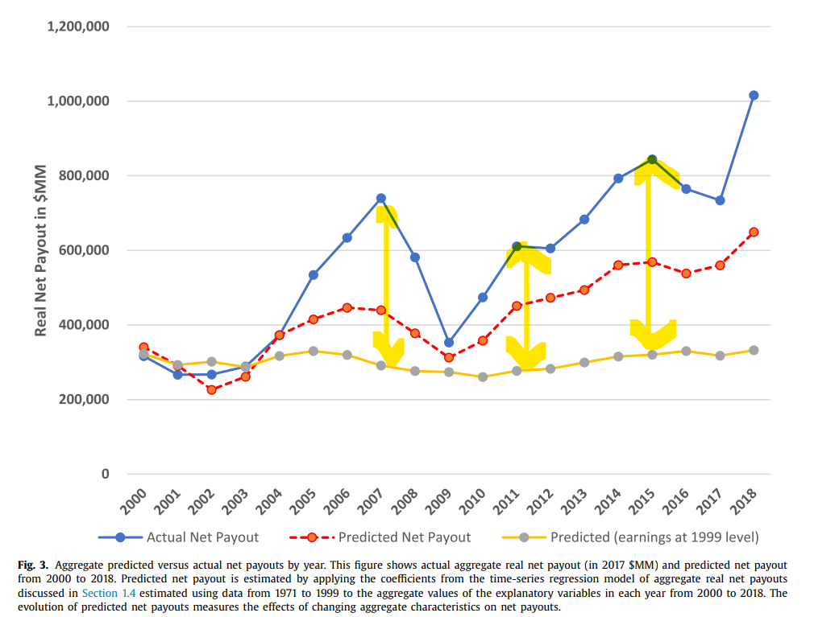
Can Macroeconomic Factor Explain Payout?
Freezing earnings in 1999 level leaving the change cause by Baa bound and GDP

Slide 23
Firm characteristic difference between Top Payers & Payers
 | Top Payers | Payers
Operating Cash Flow & Free Cash flow | High | Low
Capital Investment | Decrease | Decrease

Slide 24
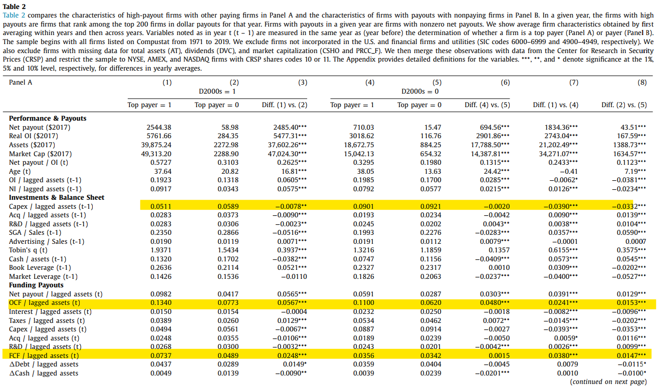
Firm characteristic difference between Top Payers & Payers
Decrease in capital spending
OCF & FCF difference between payers

Slide 25
Firm characteristic difference between Payers & Non Payers
 | Payers | Non Payers
Fund (from decrease in investment ) Usage | Payout | Increase in R&D (Research and Development )
Possible Explanation | Older firms already Built much intangible Assets | New firms building intangible Assets

Slide 26
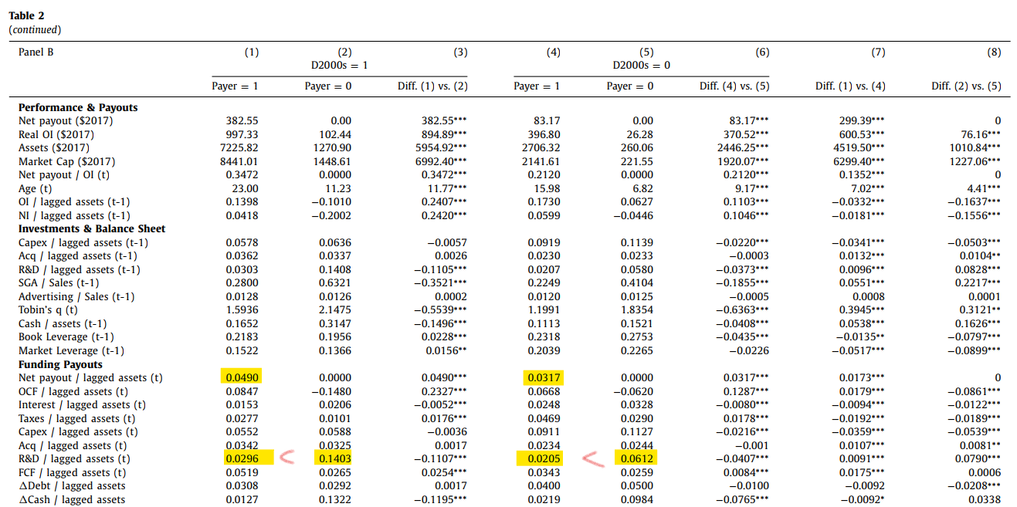
Firm characteristic difference between Top Payers & Payers

Slide 27
How much can change in firm characteristic explain the increase in payout rate?
After discussing the difference in firm characteristics, this study then measures the impact brought by firm characteristics.
The study shown that 56.79% of the increase in increasing payout rate can be explained by firm characteristics
The impact is measured by regression coefficient multiplying the rate of change

Slide 28
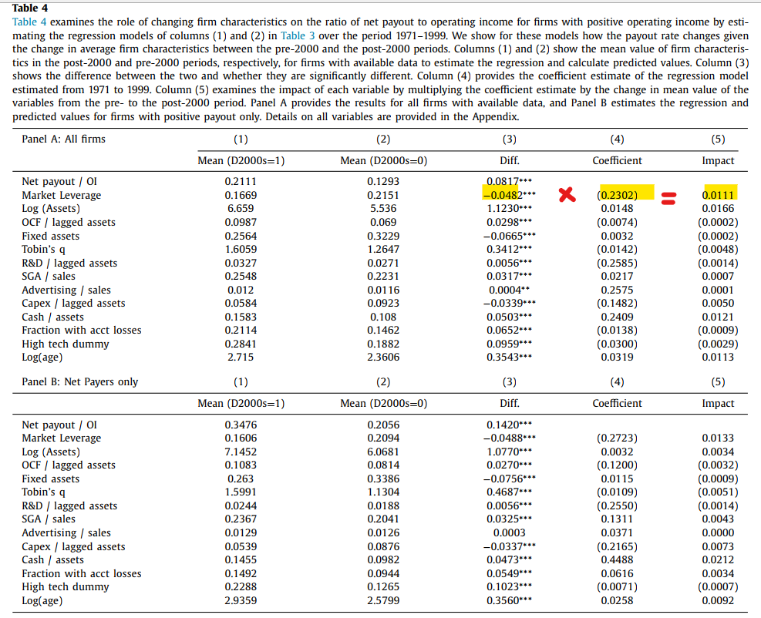
How much can change in firm characteristic explain the increase in payout rate?

Slide 29
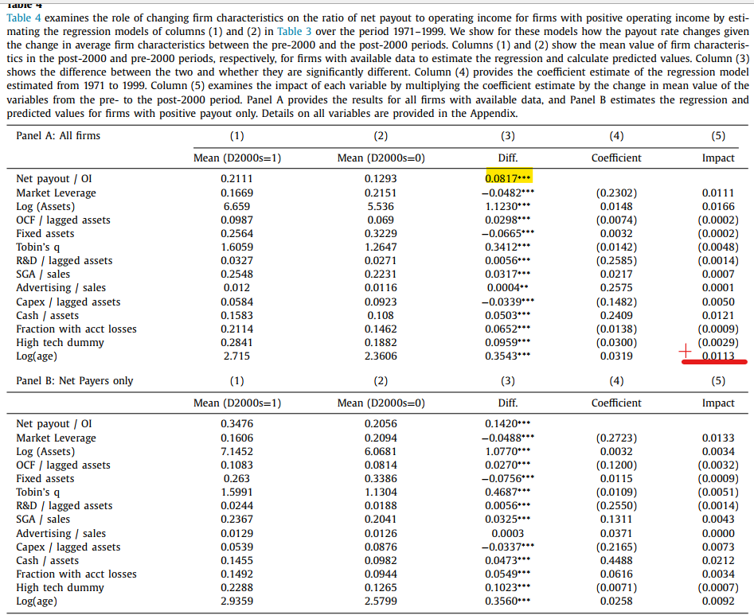
How much can change in firm characteristic explain the increase in payout rate?
0.0817/0.0465 = 0.5679
0.0465

Slide 30
Which firm characteristic matter most? (In order of importance)
cash holdings
leverage
age
capital expenditures

Slide 31
Besides Firm Characteristics, Firms are more Sensitivity to Determinants of Payout in 2000s
By performing regressing payout rate on free cash flow and it’s interaction term of time (2000ss dummy ) the study shown that firms sensitivity to determinants of Payout occurs in the 2000s
In the model with firm fixed effects, an increase in FCF from 0% to 10% increases payouts from 1.7% to 1.702%. The same change in the 2000s increases payouts to 2.76%. It thus follows that the sensitivity of payouts to FCF is much higher in the 2000s

Slide 32
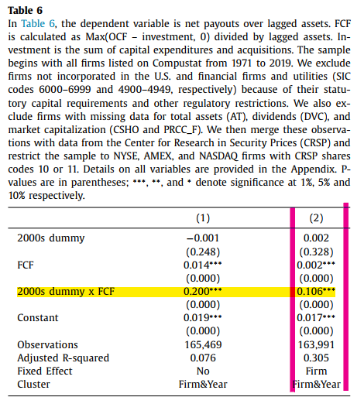
Besides Firm Characteristics, Firms are more Sensitivity to Determinants of Payout in 2000s

Slide 33
Back to the origin, what causes more payout ?
Firm characteristics (e.g. cash flow / capital expenditure / leverage etc.)
Firms Sensitivity to Determinants of Payout

